Slide 1
Incluwork
Vamsi Krishna Poluru - 002924538
Soumya Ganesh - 002812787
Malini Janaki Sankaran - 002816185
Apurva Raj - 002278877

Slide 2
OVERVIEW
IncluWork is a comprehensive web application that empowers individuals with disabilities by connecting them with inclusive employers who provide accommodations and support for an accessible work environment. Job seekers can create detailed profiles, while employers can post job listings and evaluate potential candidates. Admins verify the validity of disability documentation provided by job seekers before applications are processed. The platform intelligently matches job seeker skills with employer preferences to improve job placement and promote equal opportunities.

Slide 3
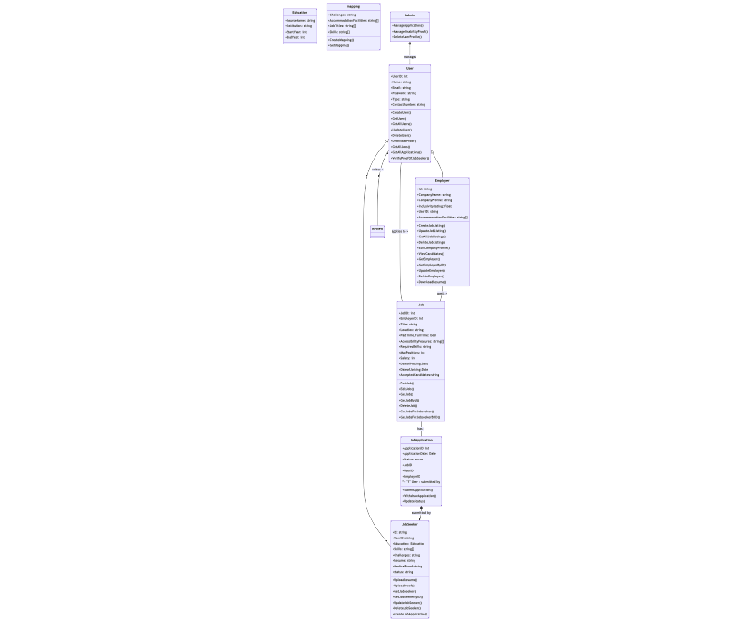
ENTITY RELATIONSHIP DIAGRAM

Slide 4
Features
Job Seeker Profile Management
Employer Profile Management
Review Management
User and Role Management
Application Oversight
User Profile Management
Job Application Tracking
job Listings Management
Job Application Process

Slide 5
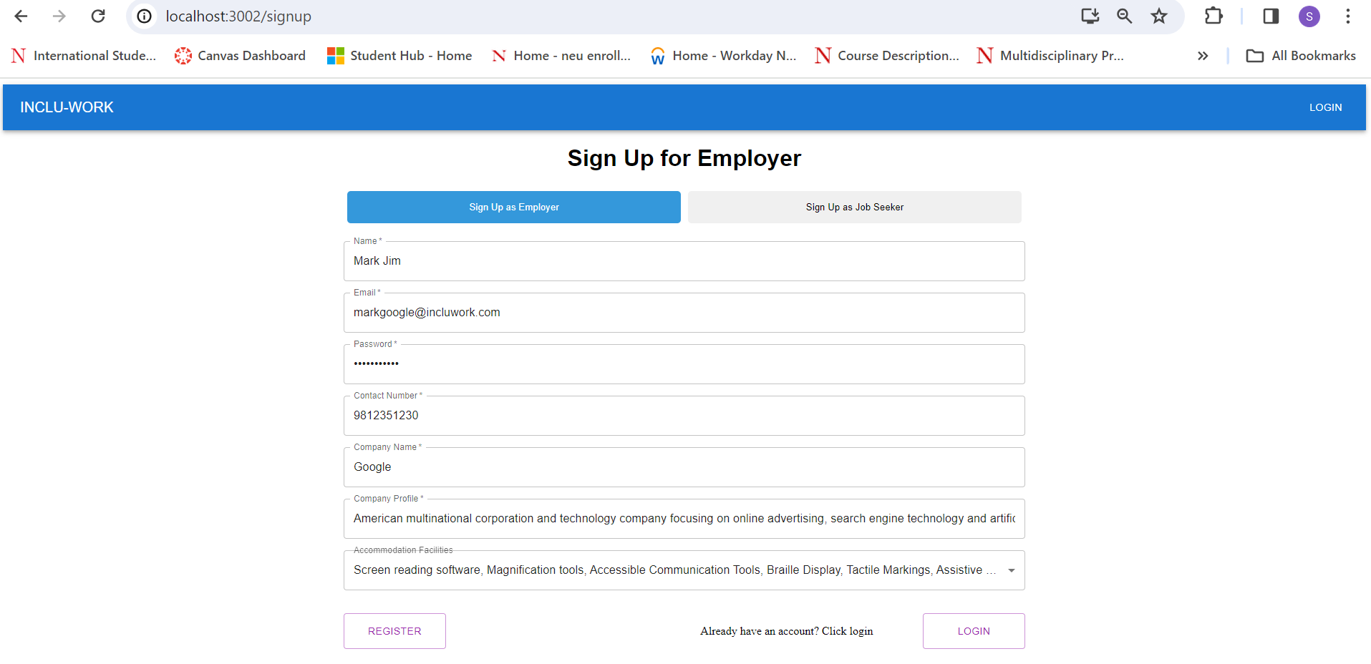
Ui

Slide 6
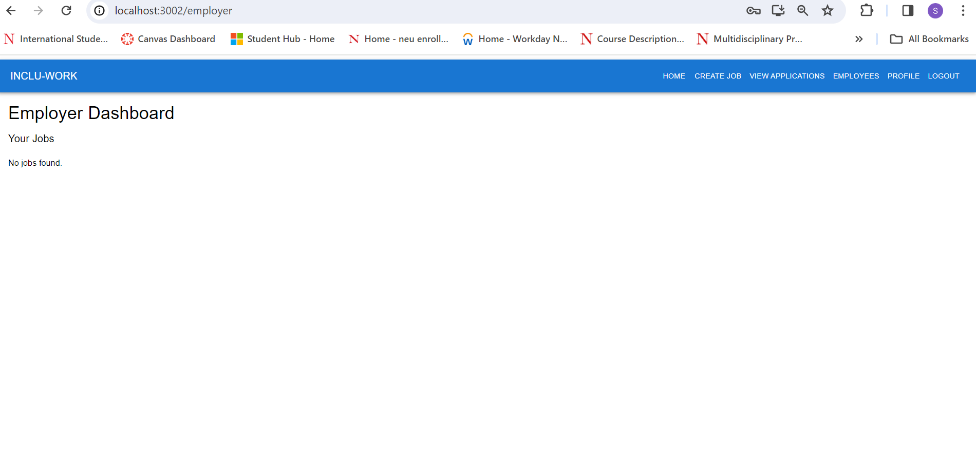

Slide 7
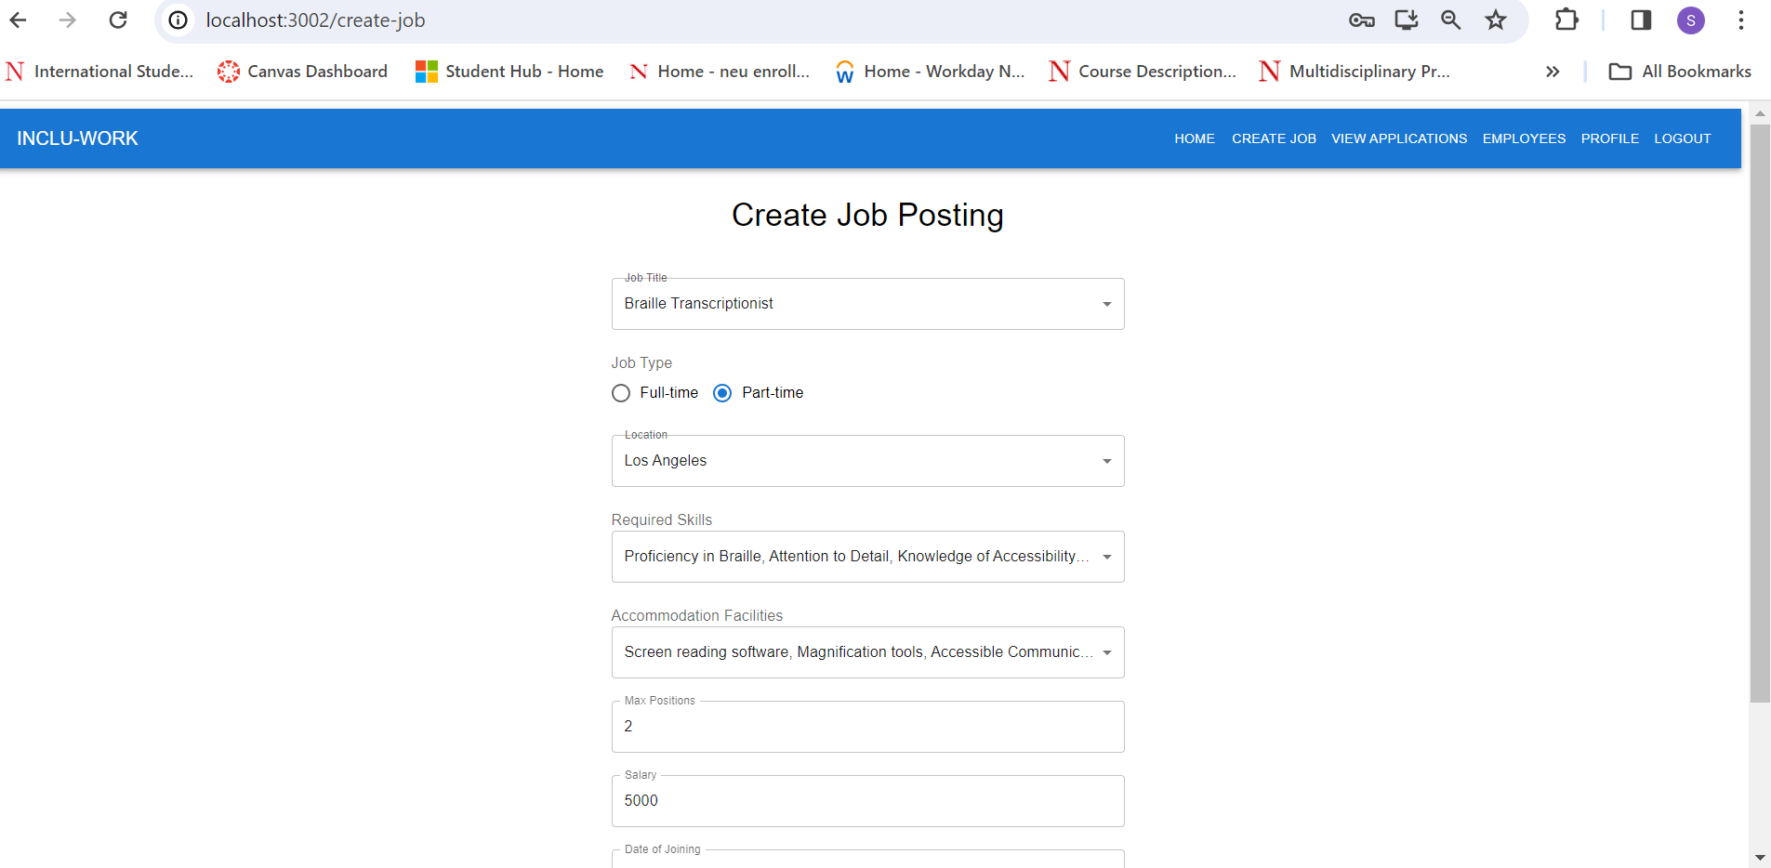

Slide 8
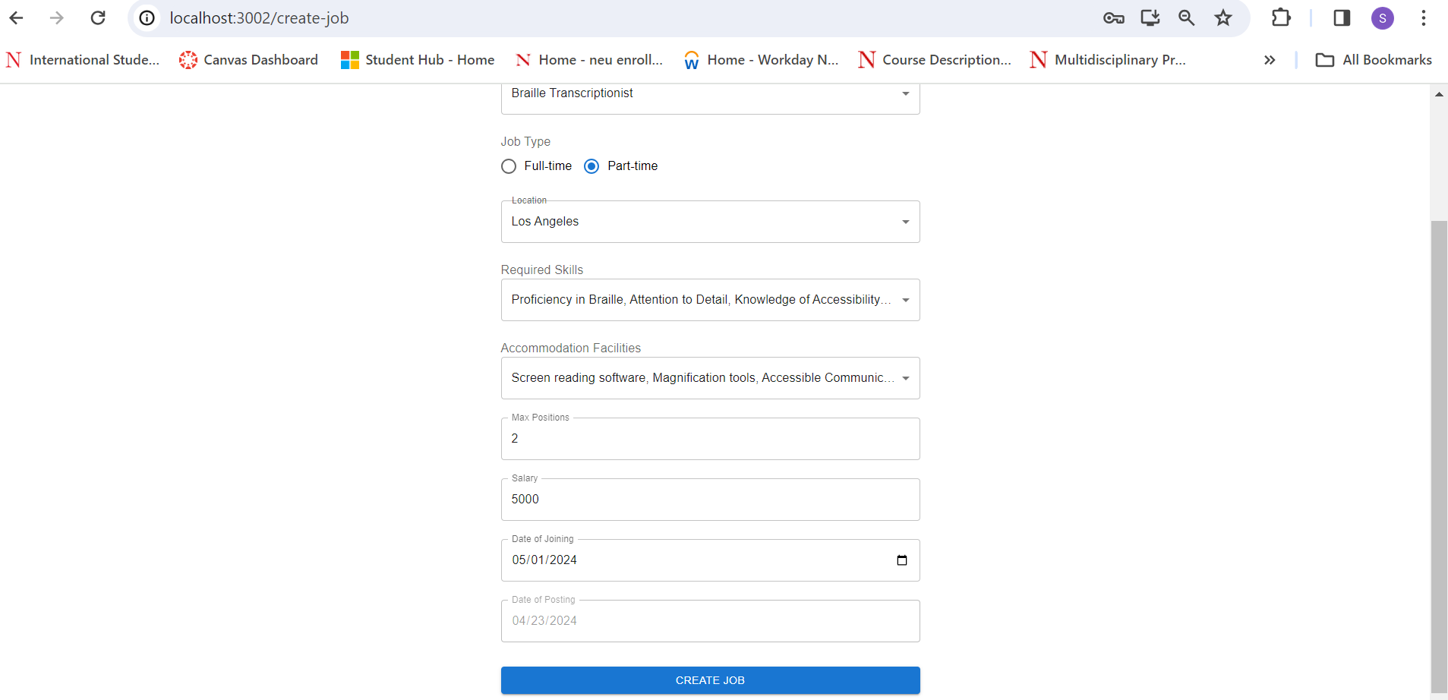

Slide 9
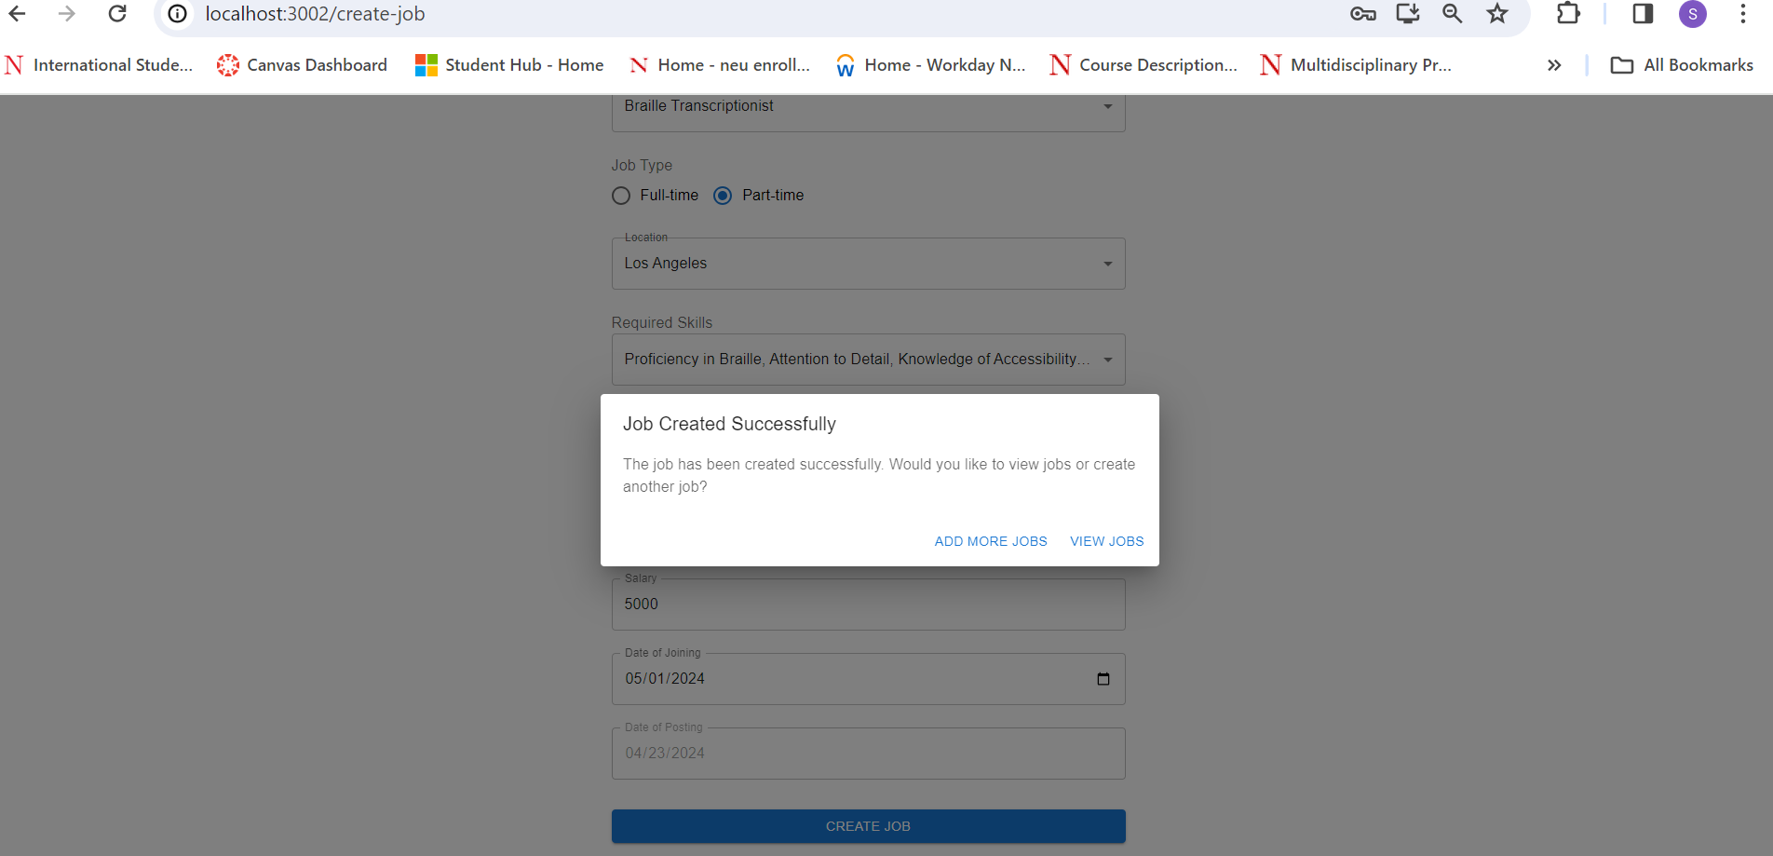

Slide 10
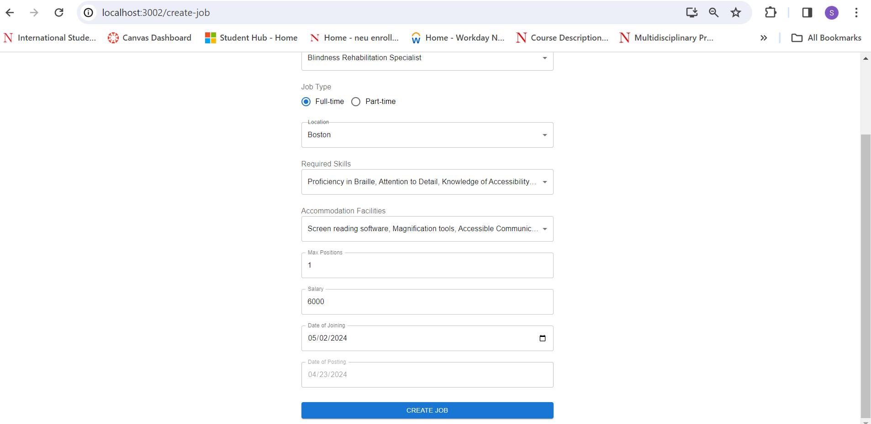
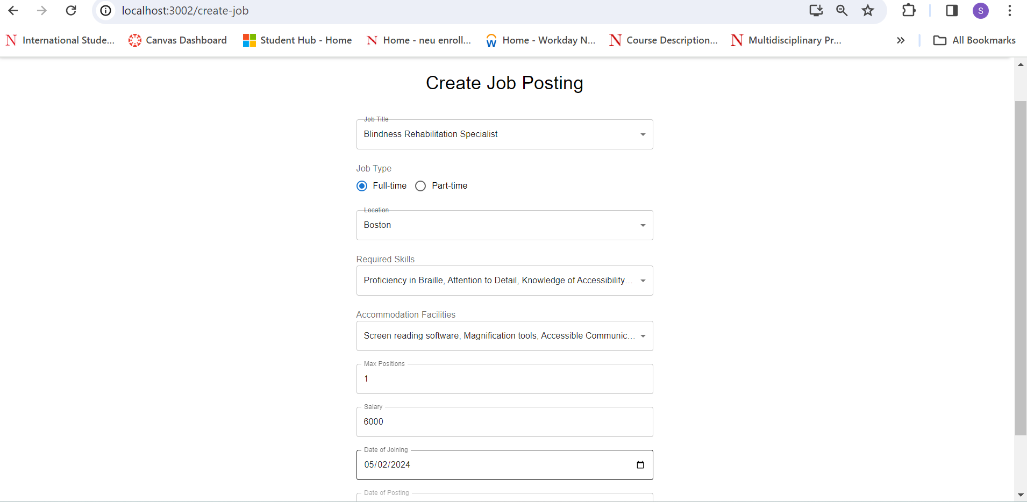

Slide 12
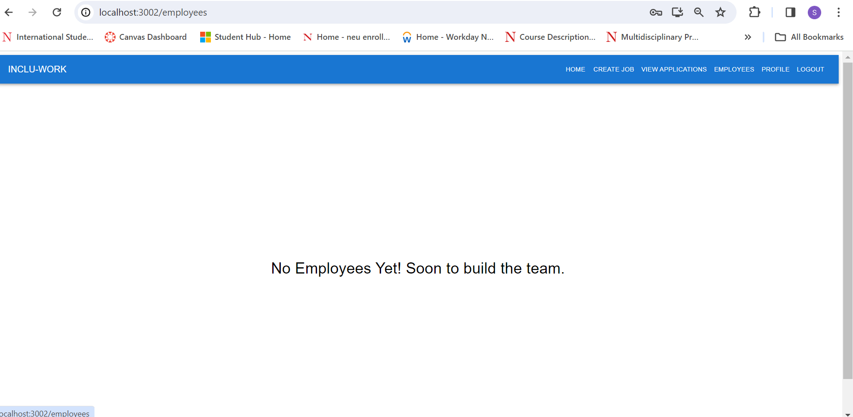

Slide 13
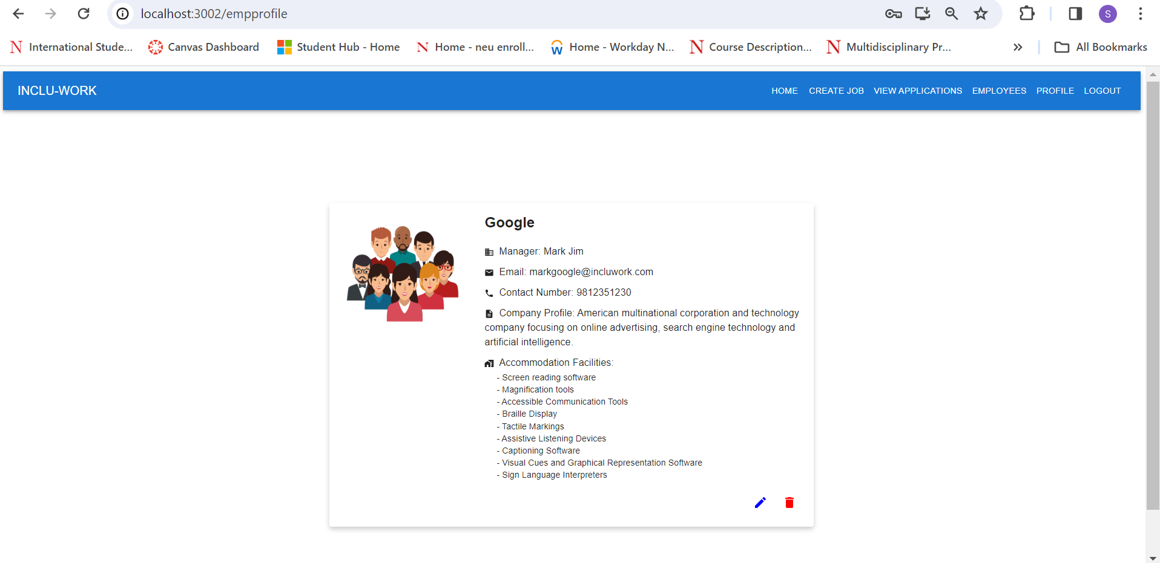

Slide 14
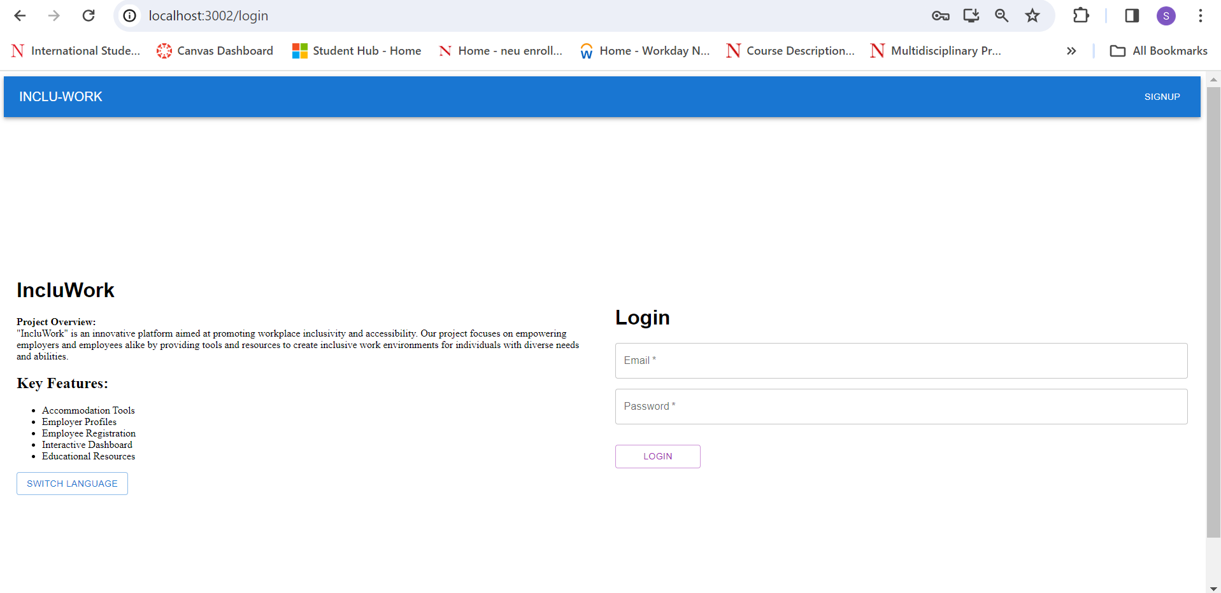

Slide 15
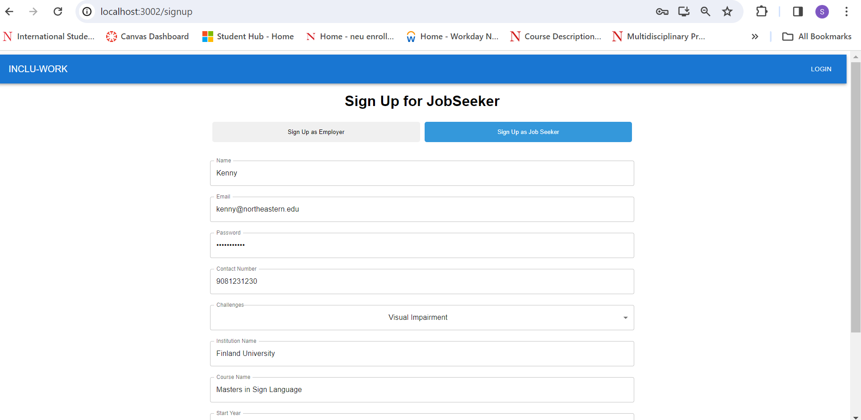

Slide 16
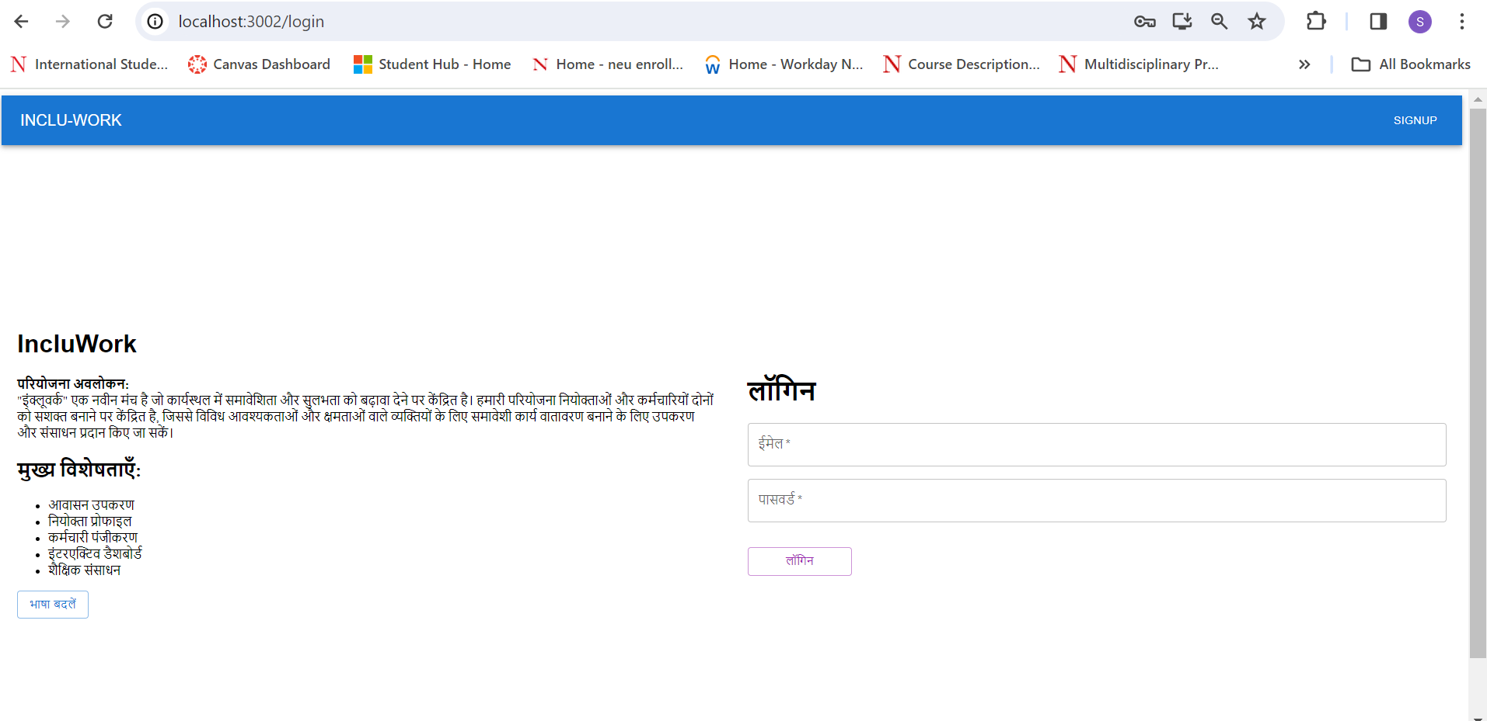

Slide 17
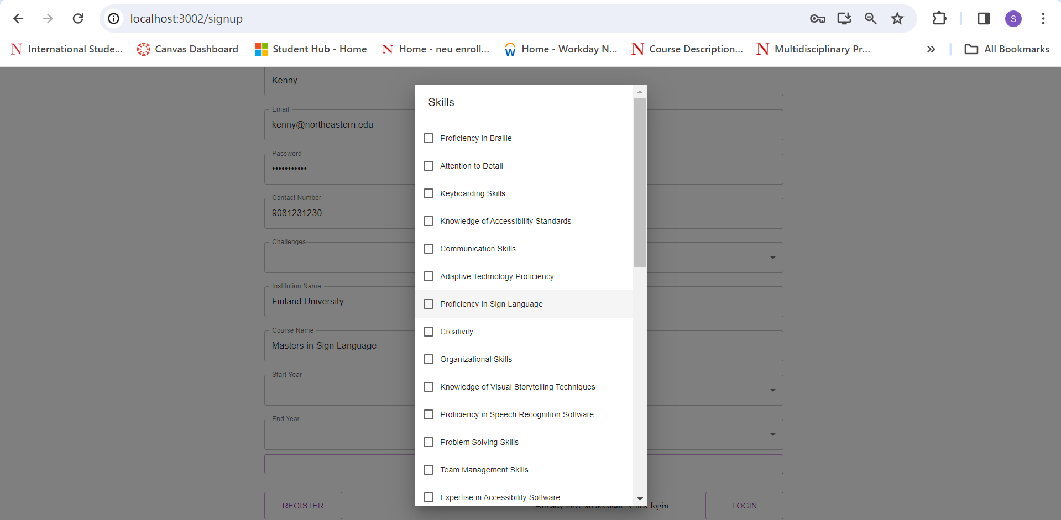

Slide 19
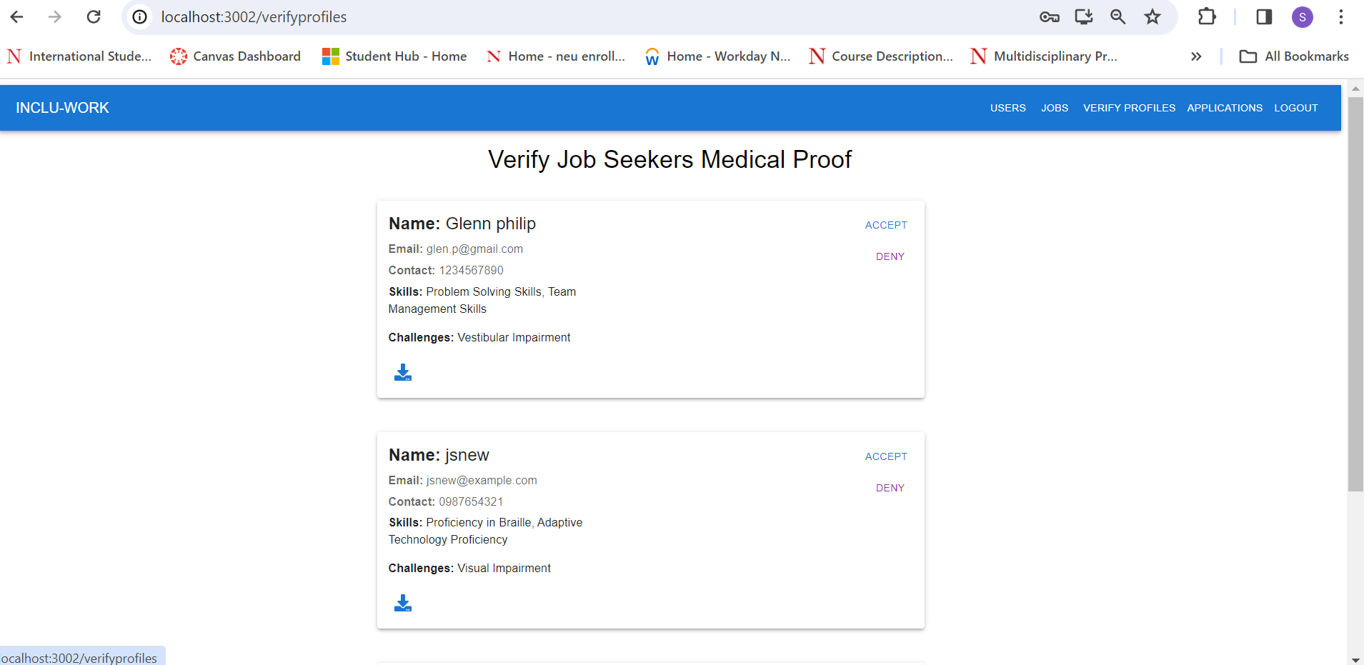

Slide 21
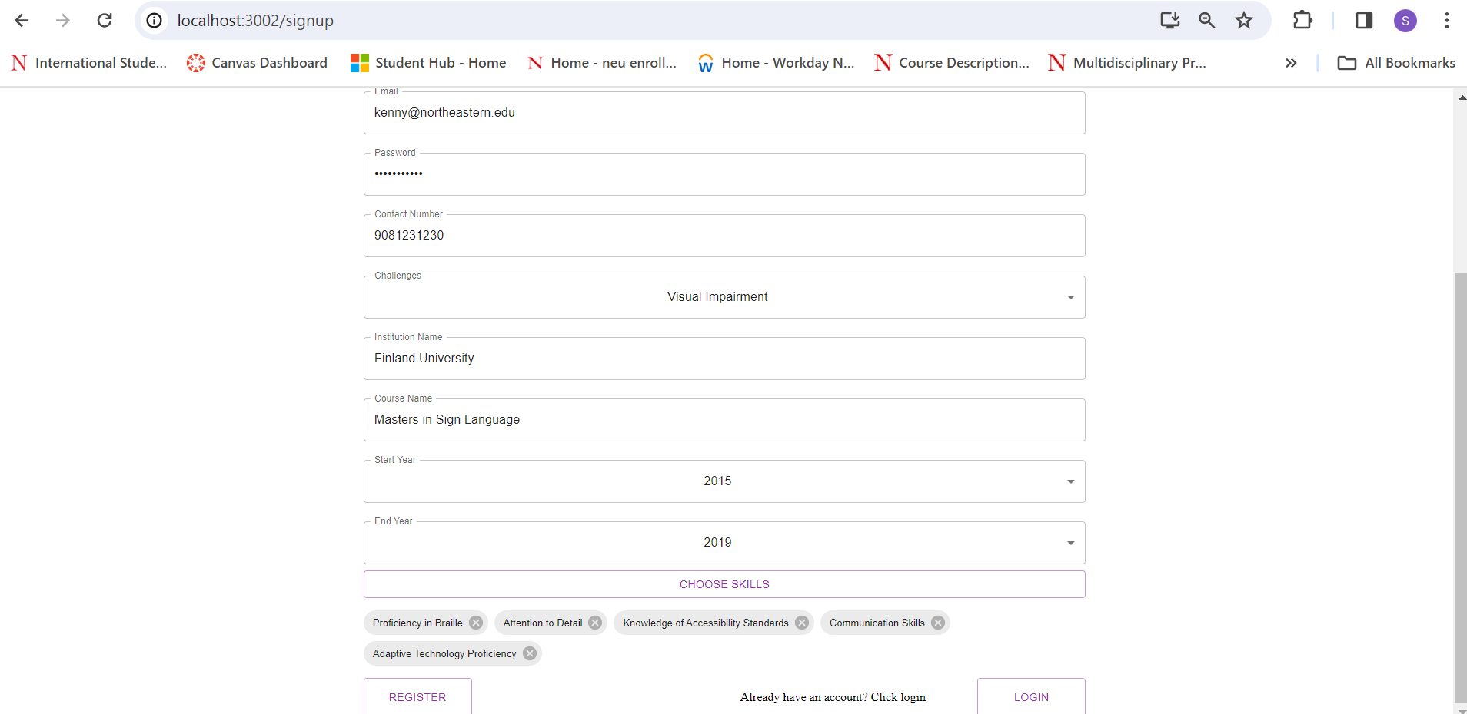

Slide 23
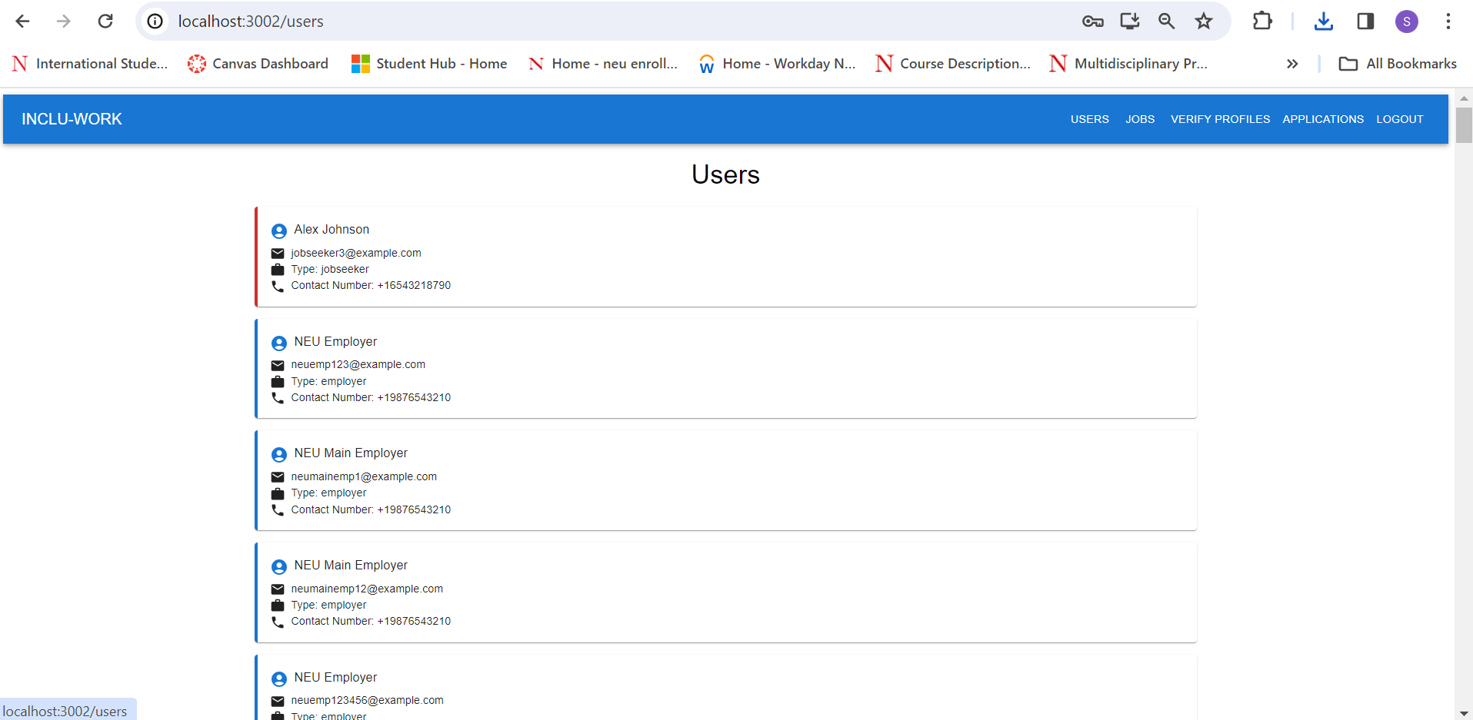

Slide 24
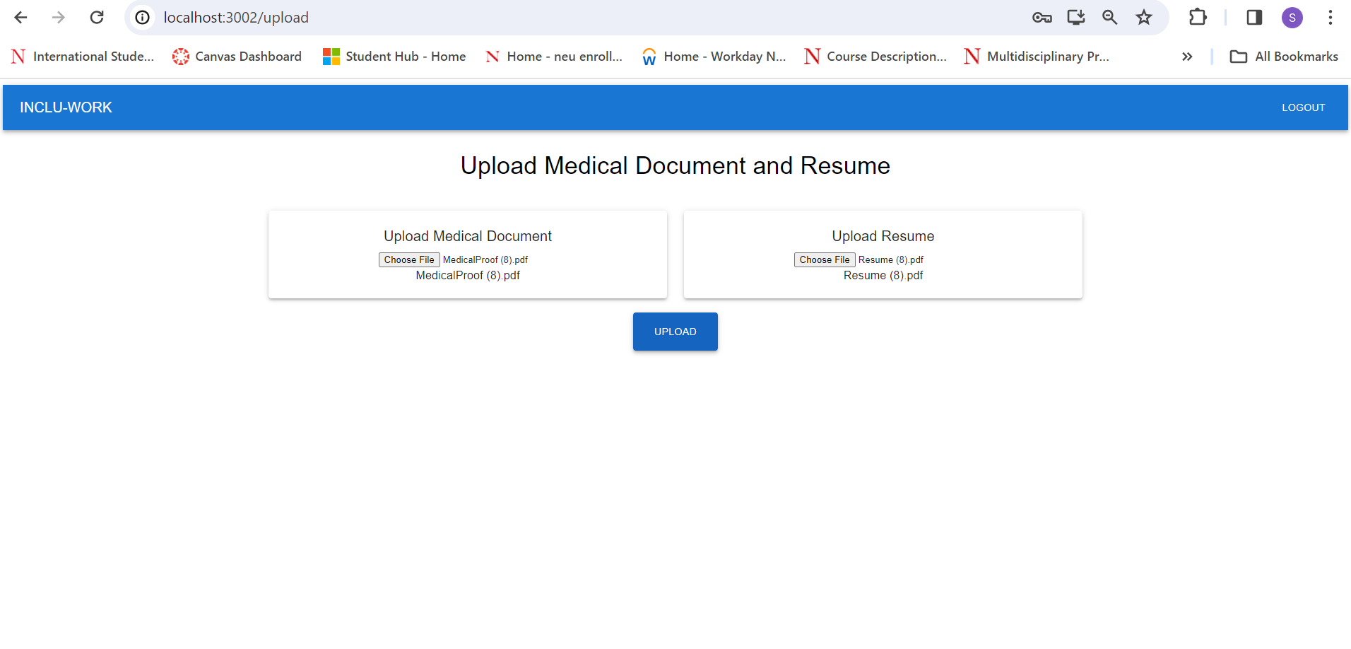

Slide 25
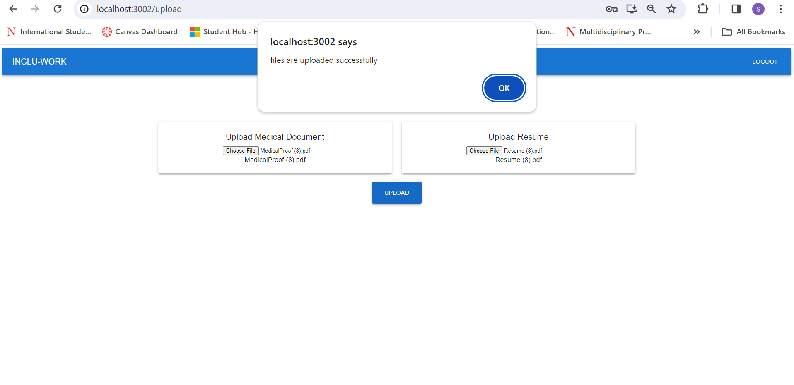

Slide 28
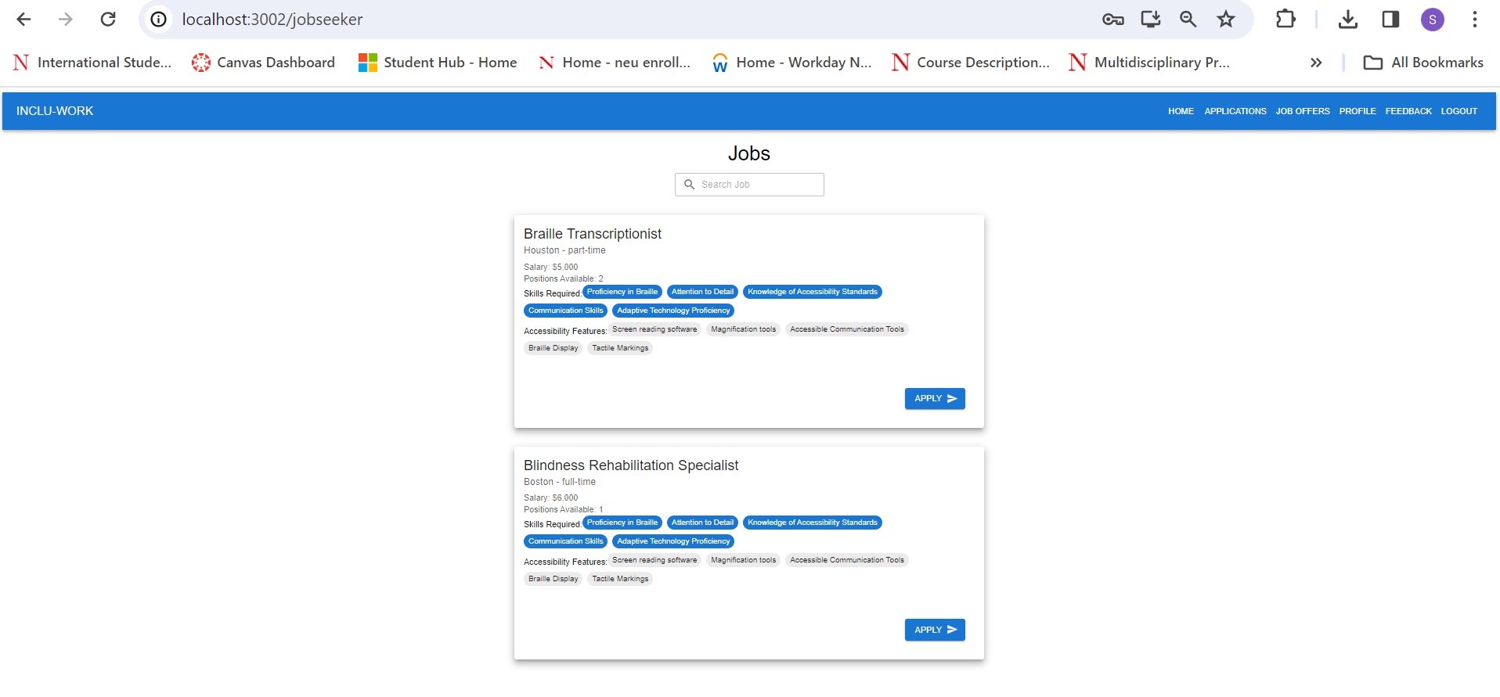

Slide 29
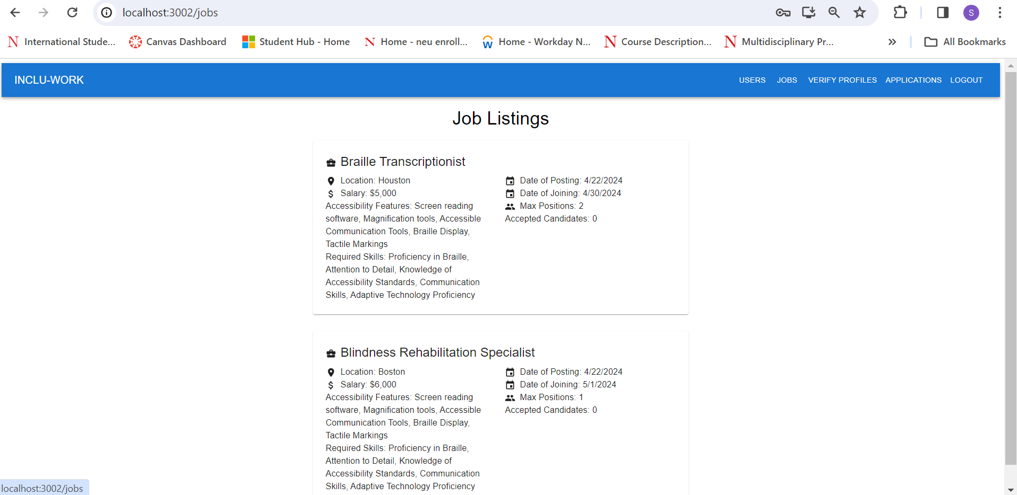
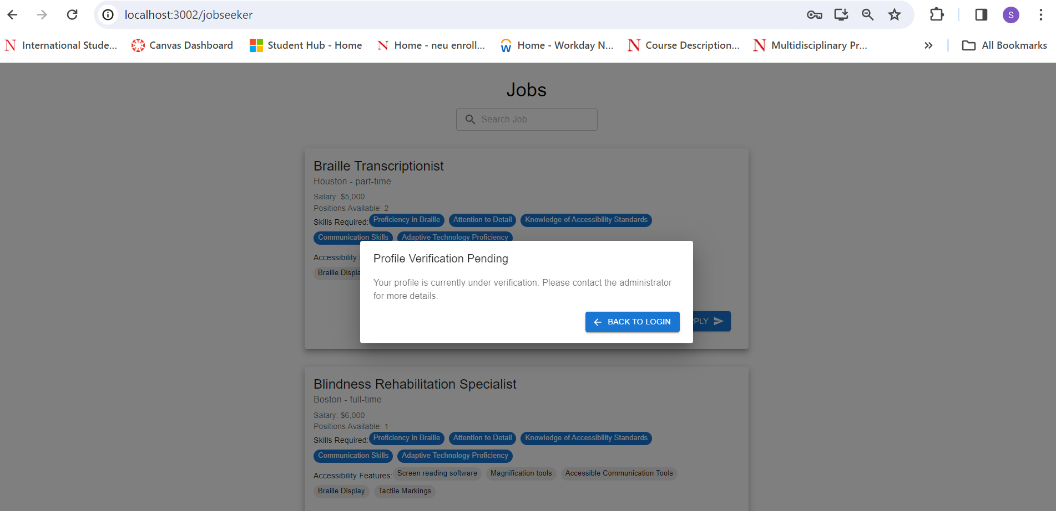

Slide 30
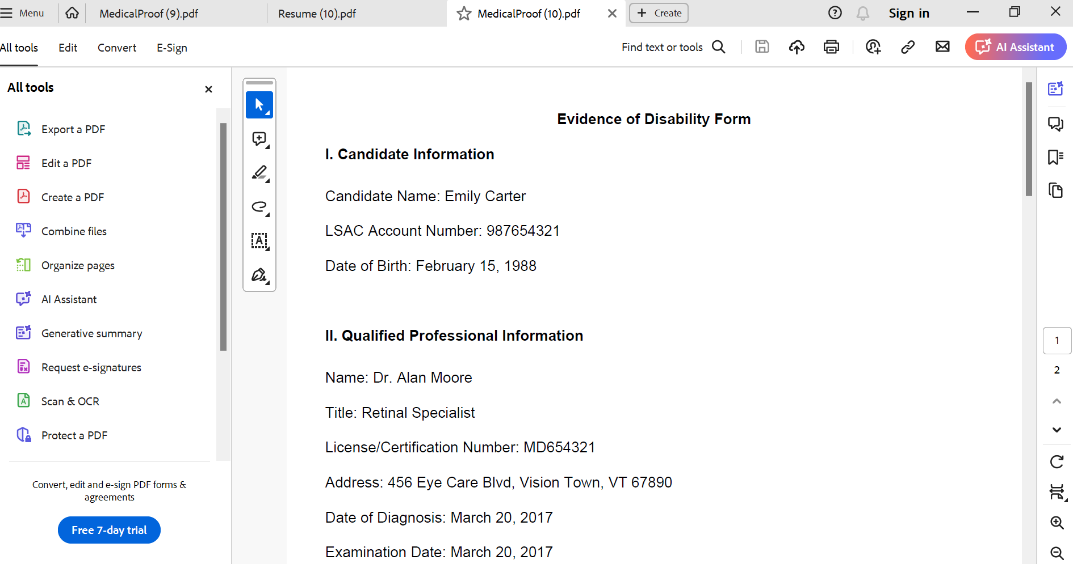

Slide 31
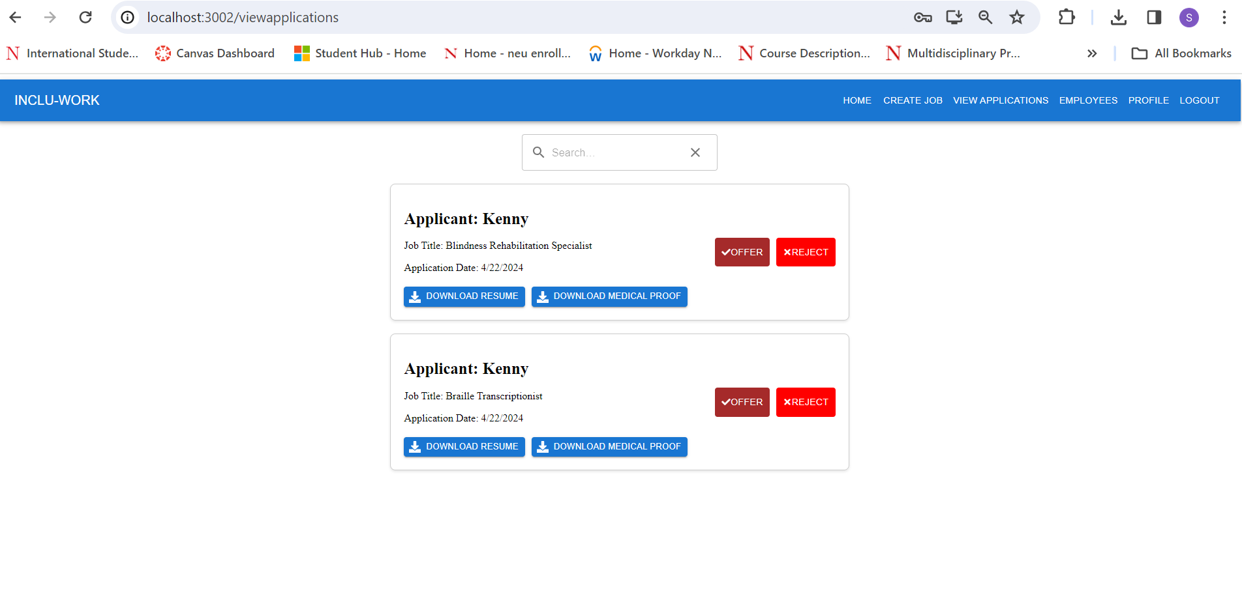

Slide 32
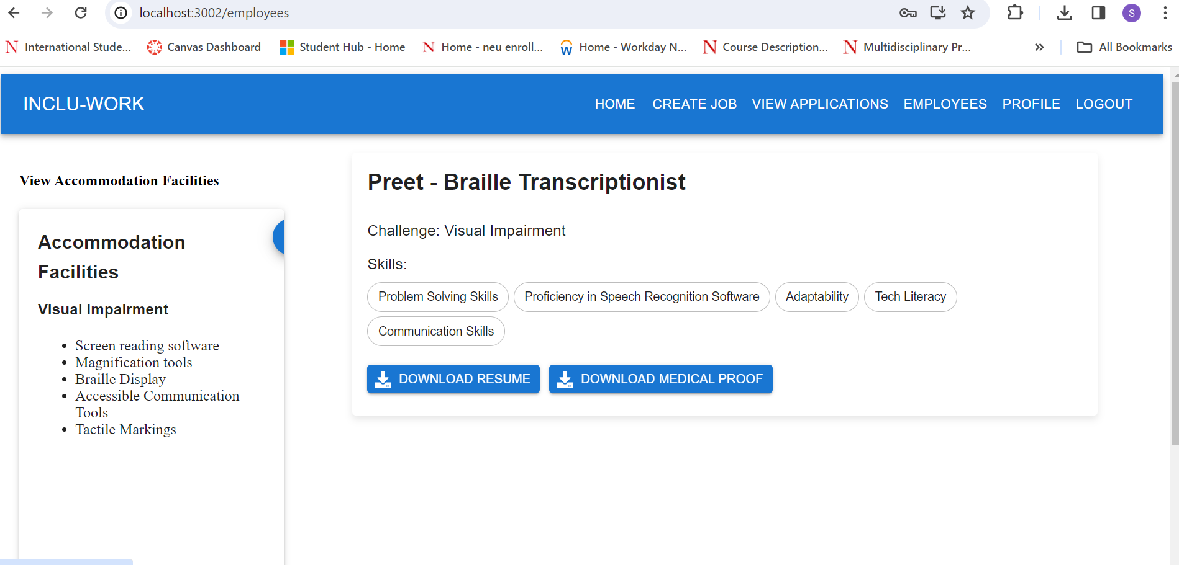

Slide 33
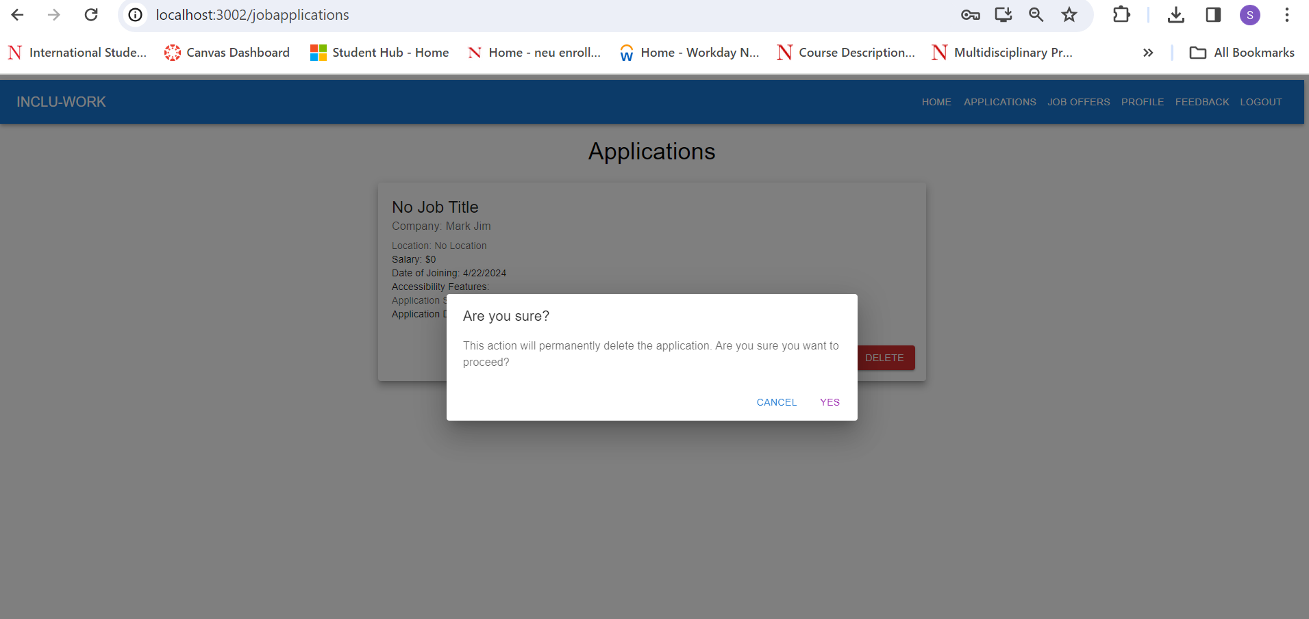

Slide 34
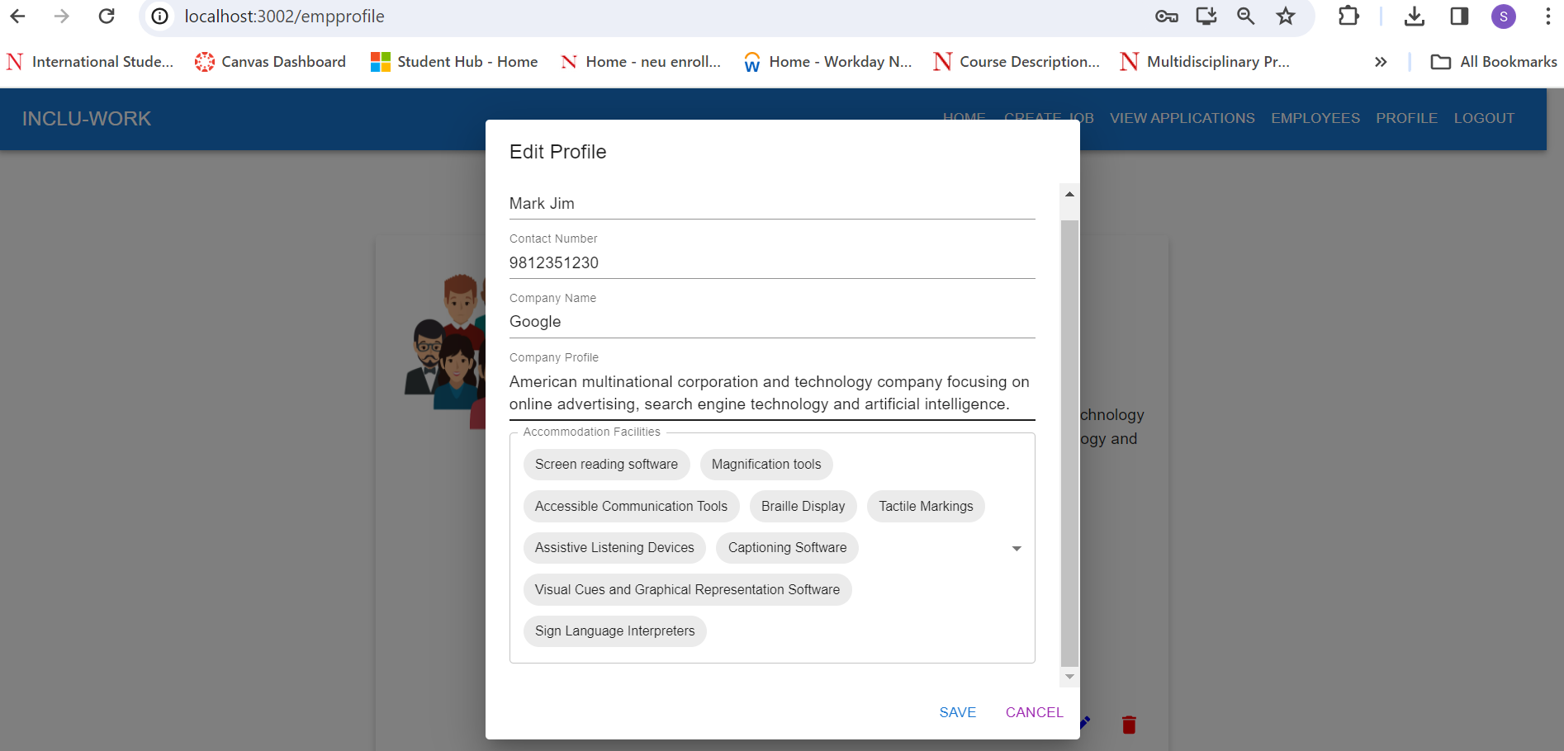

Slide 35
THANK YOU

